Slide 1
About the right length
Pick a different example to start with (ant one isn’t great)
Don’t really like the RIKZ dataset either
Go through the variance partitioning again
Re-do coefficient plot to make it look better
Standardizing x-variables: check the slide about interpreting the scaled variables
ANOVA vs t-tests in multiple regression: which one to use?

Slide 2
Multiple Regression
NRES 776
Instructor: Heather Bryan
Oct 21, 2021

Slide 3
Learning Objectives
Describe the multiple linear regression model
Interpret outputs of multiple linear regression models
Check assumptions of multiple linear regression models
Explain multicollinearity and why it can cause problems in multiple regression
Conduct inference using multiple linear regression
Standardize explanatory variables

Slide 4

Multiple Regression Model
analyzes the relationship between a response variable and more than one explanatory variable(s)
$$y_{i}= β_{0}+β_{1}x_{i1}+β_{2}x_{i2}+⋯+β_{p}x_{ip}+ε_{i}$$
$$ε \sim Normal(0, σ^{2})$$
Notes:
Goal is to test relationship between one dependent variable and several independent variables

Slide 5
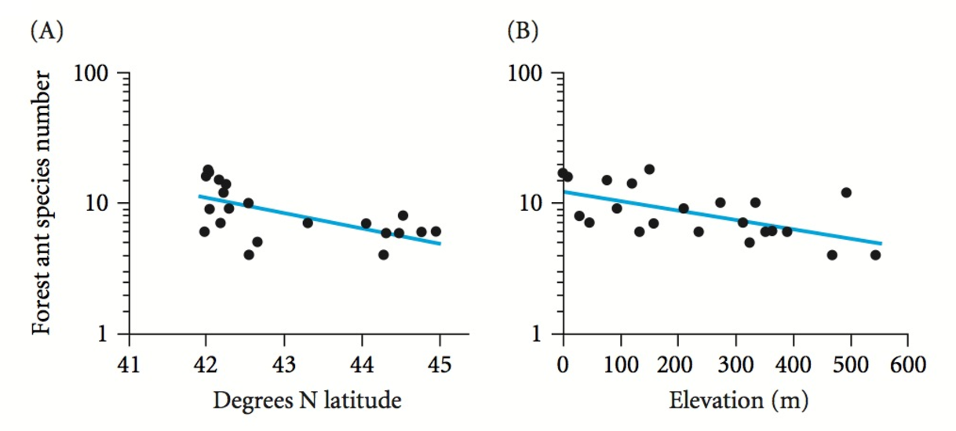
Example: ant species
$$\log_{10}\left(S\right)=4.879−0.089x_{lat}−0.001x_{alt}$$

Slide 6
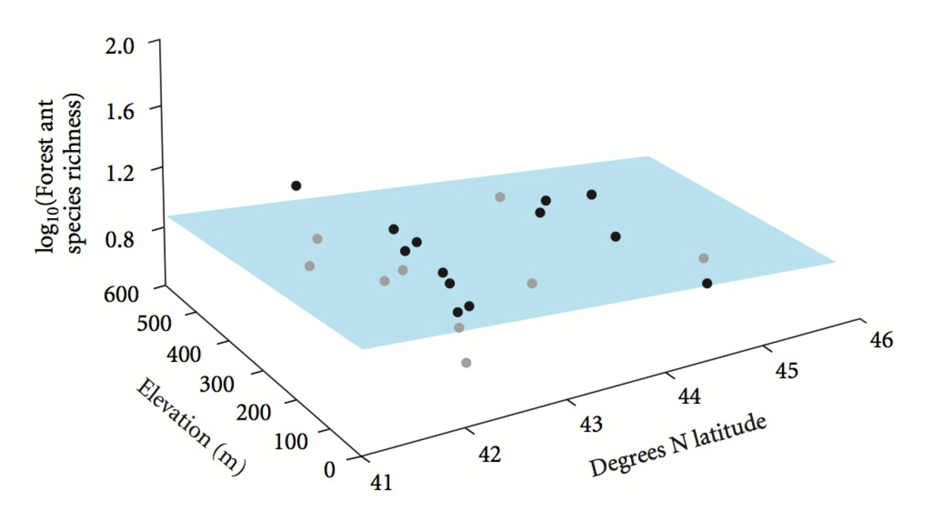
Example: ant species
$$\log_{10}\left(S\right)=4.879−0.089x_{lat}−0.001x_{alt}$$
Notes:
-least-squares solution passes a plane through cloud of points (rather than through individual variables)
-plane positioned to minimize the sum of squared vertical deviations from the plane

Slide 7


Interpretation of intercept and slopes
$$\log_{10}\left(S\right)=4.879−0.089x_{lat}−0.001x_{alt}$$
Intercept ($β_{0}$): value of$y$ when all $x$ variables equal zero
Slopes ($β_{1},β_{2 }$ $⋯$ $β_{p }$): change in $y$ per unit change in a given $x$, when all other $x$variables are held constant

Slide 8



Variance Components
$$SStotal=\sum_{i}^{n}{{{(Y}_{i}−\overline{Y})}^{2}}$$
$$={SS}_{regression}+SSresidual$$
$$SSresidual= \sum_{i}^{n}{{{(Y}_{i}−\hat{Y})}^{2}}$$
$${SS}_{regression}= \sum_{i}^{n}{{{(\hat{Y}}_{i}−\overline{Y})}^{2}}$$
df = n-p-1
Where p = number of independent variables

Slide 9
Multiple Regression Model
Does the overall regression model explain more variability in the dependent variable than would be expected by chance?
-NHST: Significant?
-Alternative: More than null model with no variables?
Notes:
Goal is to test relationship between one dependent variable and several independent variables

Slide 10


Hypothesis Testing in Multiple Regression (Overall model fit)
H₀: $β_{1}=β_{2}$……=$β_{p}=0$
H₁: at least one $β_{1}≠0$
$$F_{(p,n−p−1)}=\frac{{ss}_{REG}/p}{{SS}_{RES}/(n−p−1)}$$
$R^{2}=\frac{{ss}_{REG}}{{SS}_{Total}}$ = Total % explained variation by model
Notes:
p=number of independent variables in the model

Slide 11
Multiple Regression Model
Does the overall regression model explain more variability in the dependent variable than would be expected by chance?
-NHST: Significant?
-Alternative: More than null model with no variables?
How much variability is explained by each of the dependent variables?
-NHST: Which variables explain a significant amount of the variability in y?
-Alternative: How much variance in y is explained by each independent variable? Which variables explain the most variability in y relative to other variables? Biological relevance?
Notes:
Goal is to test relationship between one dependent variable and several independent variables

Slide 12



Hypothesis Testing in Multiple Regression (Partial)
H₀: $β_{2}=0$
H₁: $β_{2}≠0$
Full Model
$$y_{i}= β_{0}+β_{1}X_{1}+β_{2}X_{2}+ε_{i}$$
Reduced Model
$$y_{i}= β_{0}+β_{1}X_{1}+ε_{i}$$
${SS}_{Regression due to X_{2}}={SS}_{Reg Full}−{SS}_{Reg Reduced}$
$$F_{Partial(1,n−p−1)}=\frac{{ss}_{REG due to X_{2}}/1}{{SS}_{RES}/(n−p−1)}$$
Notes:
Next question in multiple regression is to assess whether contributions of each variable are “significant”
Done by comparing variability explained by the full model versus variability explained by the reduced model (when a particular term is left out)
This will give us the contribution of each variable
If F-test is significant, it means that variable has a significant effect on y
F-partial always based on full model
Keep in mind that you will get a different result depending on what order the variables are entered in the model

Slide 13

Hypothesis Testing in Multiple Regression (Partial)
${R_{partial for X_{2}}}^{2}=\frac{{ss}_{REG due to X_{2}}}{{SS}_{Total}}$ = % explained by X₂
$$R_{Full}^{2}= \sum{R_{Partial}^{2}}$$
Notes:
Can also use this approach to calculate the amount of variability explained by each variable independently (partial R-squared)
The partial r-squared values sum to the full r-squared
Note that you need to be careful about the number of variables you include in the model.
Each variable will explain some variation in y due to chance alone.
If you include enough variables in your model, you will end up with an R2 of 1 even if none have substantial predictive power
Most stat programs therefore include an adjusted r-squared value in the output
Adjusted R-squared values correct for the number of terms in the model, and are helpful in comparing models, but can’t be use to interpret amount of variability explained in the model

Slide 14

Assumptions of multiple linear regression
The relationships between each $x$ and $y$ are linear
The variable $x$ is measured without error
For any value $x$, the sampled $y$ are independent with normally distributed errors (residuals)
The residual variance is constant
There is no multicollinearity (check before fitting model)

Slide 15
Multicollinearity
Occurs when there 2 or more explanatory variables are correlated (r > 0.6)
Two or more variables are redundant so effects can’t be separated
Inflates SE and leads to Type II error
check correlations between explanatory variables before fitting multiple regression model

Slide 16

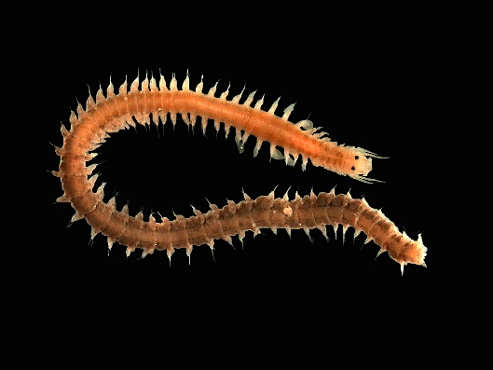

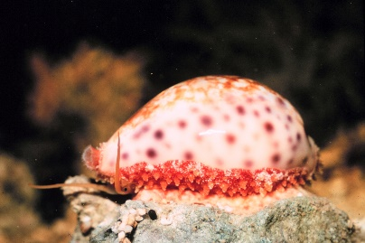
Example: Effects of abiotic characteristics on benthic invertebrates on Dutch beaches
Species richness at 45 sites
Environmental data
NAP: Reflects time site is underwater
Grain size of sand
Week
Notes:
Beach Image: https://thenetherlandsbynumbers.files.wordpress.com/2014/07/dutch-coast.png
Other images: wikipedia

Slide 17

Example: Effects of abiotic characteristics on benthic invertebrates on Dutch beaches
Model:
$${Richness}_{i}={constant+β}_{1}∗{NAP}_{i}+β_{2}∗{Grainsize}_{i}+β_{3}∗{Week}_{i}$$

Slide 18
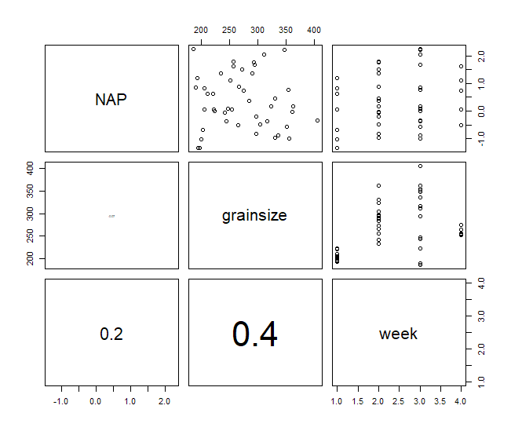
Example: Check for Colinearity (Pairplot)
Notes:
Want a correlation coefficient below 0.7 or 0.6 to avoid issues with colinearity

Slide 19
Example: Check for Colinearity (variance inflation factors)
Used for model diagnostics
Can flag collinearity issues especially with interaction terms
Want VIF <5, VIF 5-10 reveals moderate correlation, if Vif >10, then there are be problems with colinearity
 | GVIF | df | GVIF^(1/(2*Df))
NAPscale | 1.17 | 1 | 1.08
grainsizescale | 1.94 | 1 | 1.39
factor(week) | 2.06 | 3 | 1.13

Slide 20
Regression Output
 | Estimate | Std. Error | t value | p-value
(Intercept) | 12.35 | 2.43 | 5.09 | 0.000
NAP | -2.33 | 0.49 | -4.73 | <0.001
grainsize | 0.00 | 0.01 | -0.44 | 0.663
factor(week)2 | -7.17 | 1.63 | -4.40 | <0.001
factor(week)3 | -5.68 | 1.69 | -3.35 | 0.002
factor(week)4 | -2.28 | 1.83 | -1.25 | 0.219
Notes:
Which variables are important in this model?
How would you interpret the coefficient for NAP? Week?
Why is there no estimate for Week 1?

Slide 21
ANOVA Table
 | Df | Sum Sq | Mean Sq | F value | p-value
NAP | 1 | 357.53 | 357.53 | 39.25 | <0.001
grainsize | 1 | 188.61 | 188.61 | 20.71 | <0.001
factor(week) | 3 | 200.26 | 66.75 | 7.33 | 0.001
Residuals | 39 | 355.24 | 9.11

Slide 22



Standardizing explanatory variable
$$z_{i}=\frac{x_{i}−\overline{x}}{s}$$
changes interpretation of intercept:
value zero represents mean of variable $x$
changes interpretation of slope:
change in $y$ for every unit standard deviation change in $x$
useful for comparing effect size of variables measured on different scales

Slide 23
Regression Output--Standardized
 | Estimate | Std. Error | t value | p-value
(Intercept) | 10.23 | 1.26 | 8.09 | <0.001
NAP | -2.32 | 0.49 | -4.73 | <0.001
grainsize | -0.28 | 0.63 | -0.44 | 0.663
factor(week)2 | -7.17 | 1.63 | -4.40 | <0.001
factor(week)3 | -5.68 | 1.69 | -3.35 | 0.002
factor(week)4 | -2.28 | 1.83 | -1.25 | 0.219

Slide 24
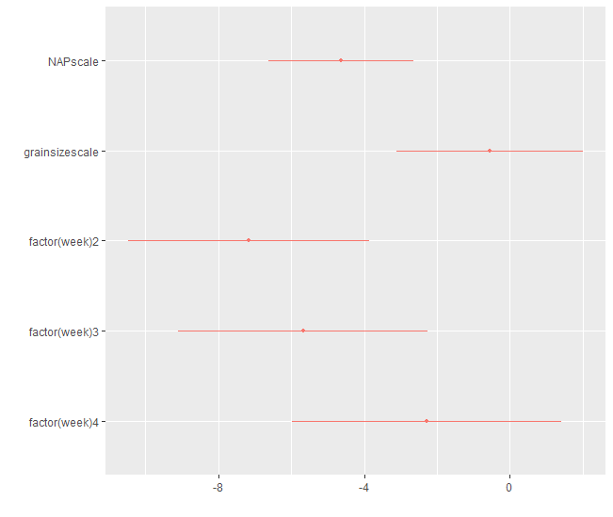
Coefficient Plot

Slide 25
Summary
Hypothesis testing in multiple regression involves assessing overall model fit and the effects of individual parameters in the model

Slide 26
Summary
Hypothesis testing in multiple regression involves assessing overall model fit and the effects of individual parameters in the model
Multicolinearity can be a problem in multiple regression because it’s not possible to partition the variance of different variables

Slide 27
Summary
Hypothesis testing in multiple regression involves assessing overall model fit and the effects of individual parameters in the model
Multicolinearity can be a problem in multiple regression because it’s not possible to partition the variance of different variables
Scatterplots and correlation coefficients are useful for checking for collinearity among predictor variables

Slide 28
Summary
Hypothesis testing in multiple regression involves assessing overall model fit and the effects of individual parameters in the model
Multicolinearity can be a problem in multiple regression because it’s not possible to partition the variance of different variables
Scatterplots and correlation coefficients are useful for checking for collinearity among predictor variables
Scaling continuous predictor variables can help with interpretation of model outputs and reduce collinearity

